Slide 1
Employee data analysis using excel
STUDENT NAME : P. Janova
REGISTER NO : 312208491
DEPARTMENT :B.com [commerce]
COLLEGE : Chellammal Women’s College

Slide 2
PROJECT TITLE
Employee profromance analysis using excel

Slide 3
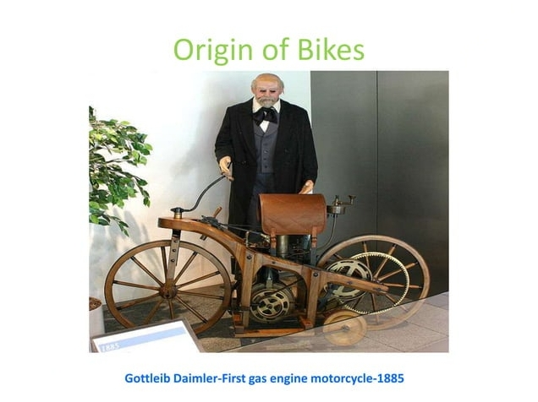

ORIGIN OF BIKES

Slide 4
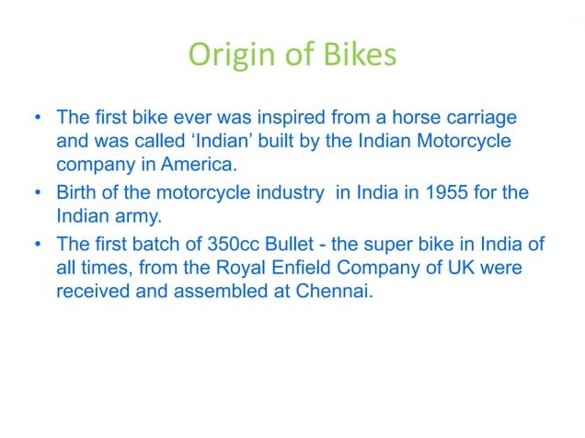

Slide 5
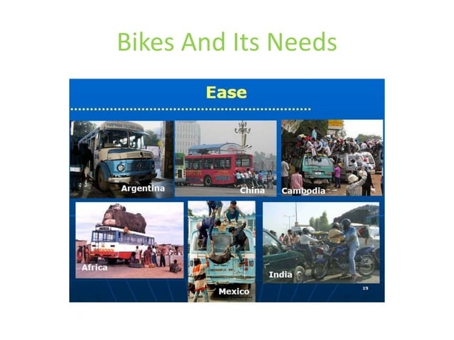

Slide 6
Motorcycle distribution across globe

Slide 7
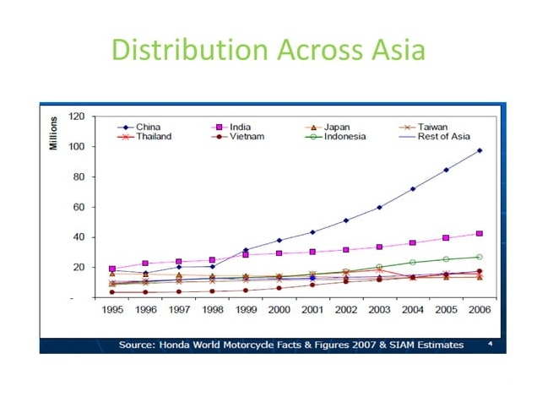

Slide 8
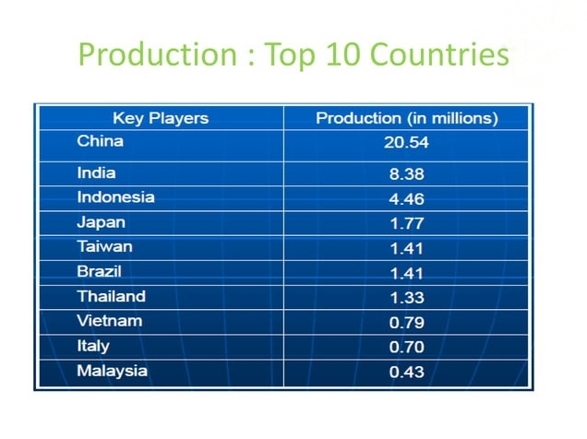

Slide 9
Second Largest markect in tha world. 5 times the size of indian passenger car market.
Sales trends in india

Slide 10
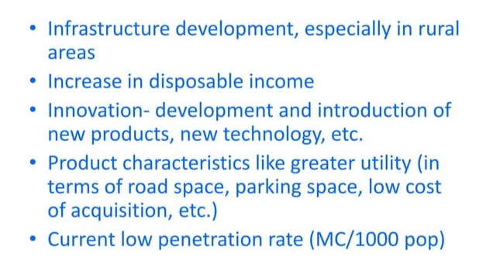
FACTORS INFLUENCING INDIAN MARKET

Slide 11


Slide 12
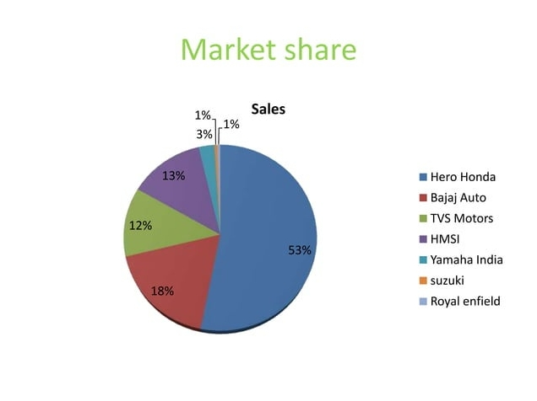

Slide 13
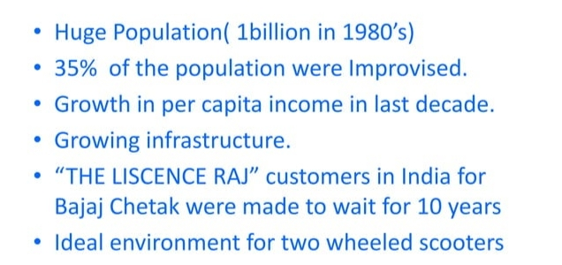
Hero Honda First To Introduce Bikes In India

Slide 14
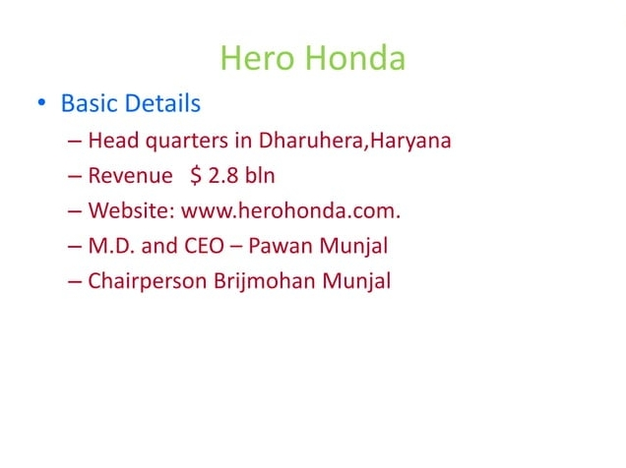

Slide 15
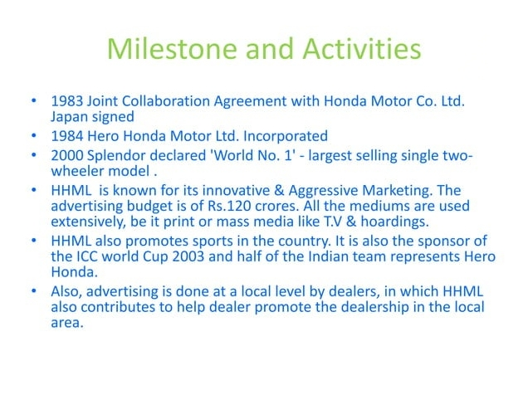

Slide 16
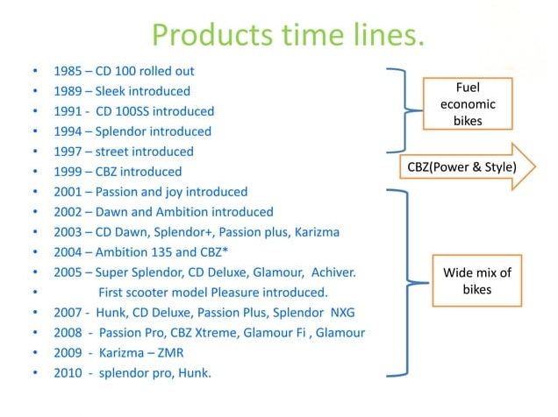

Slide 17
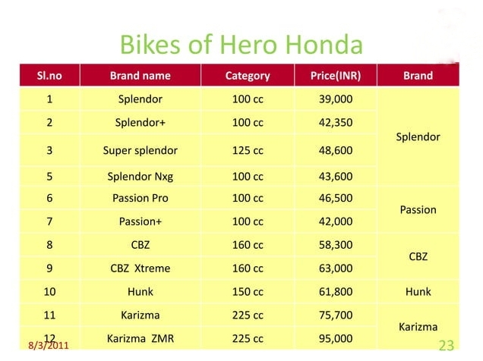

Slide 18
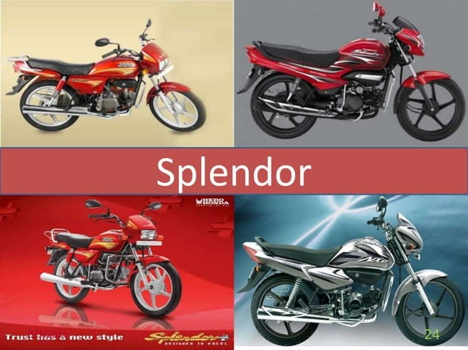

Slide 19
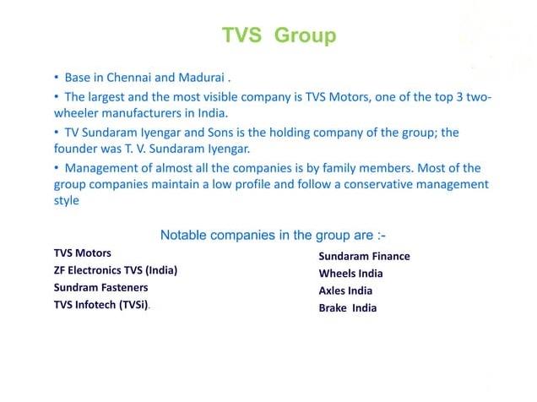

Slide 20
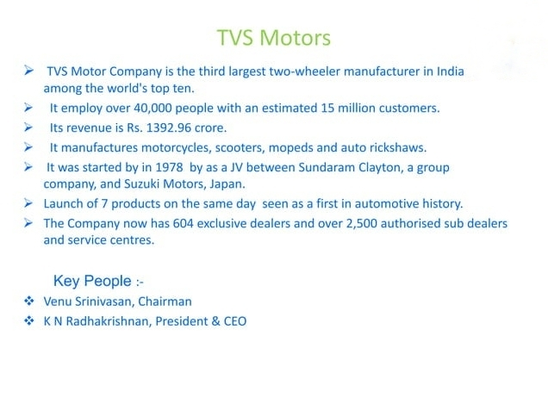


Slide 21
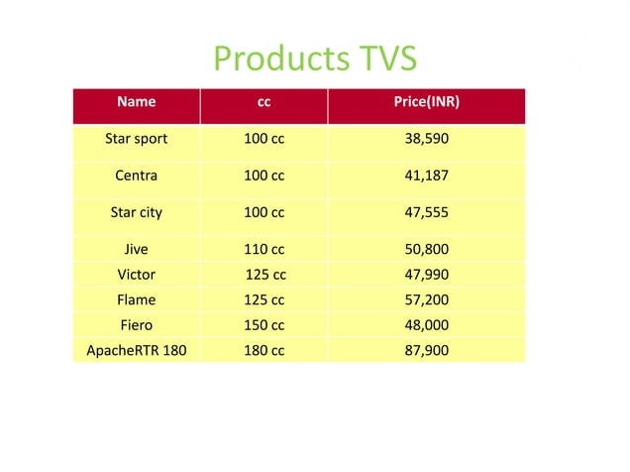

Slide 22
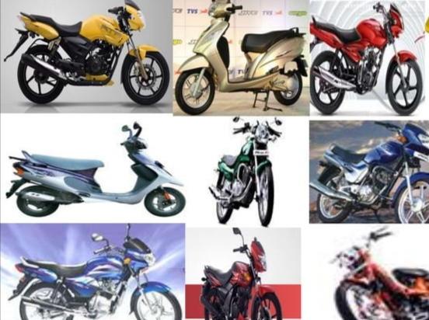

Slide 23


Slide 24
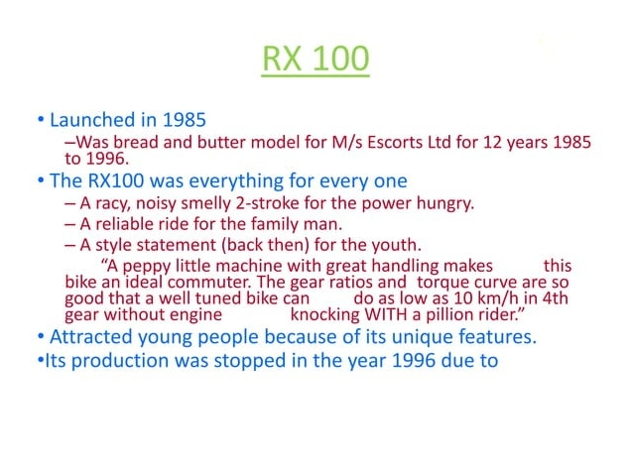

Slide 25
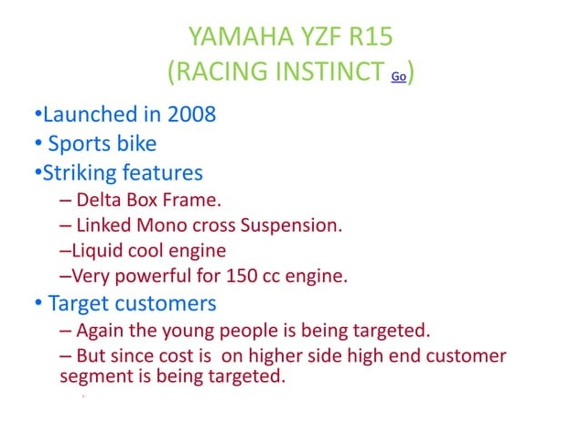


Slide 26
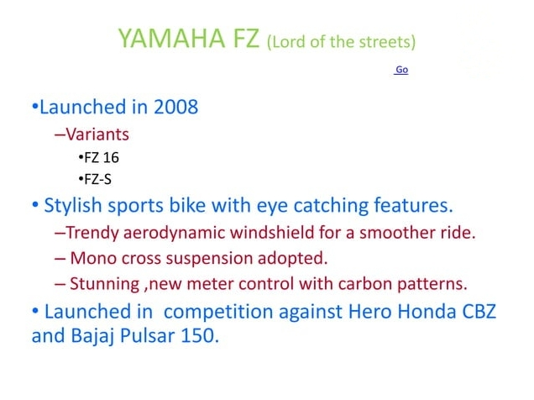


Slide 27


Slide 28
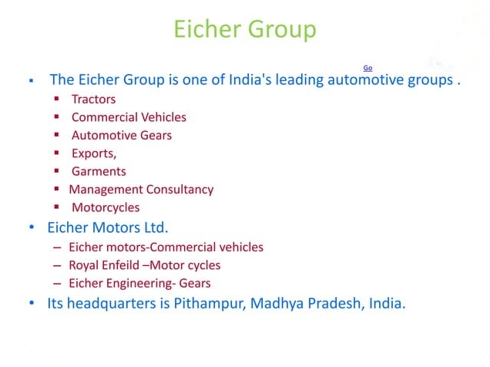

Slide 29
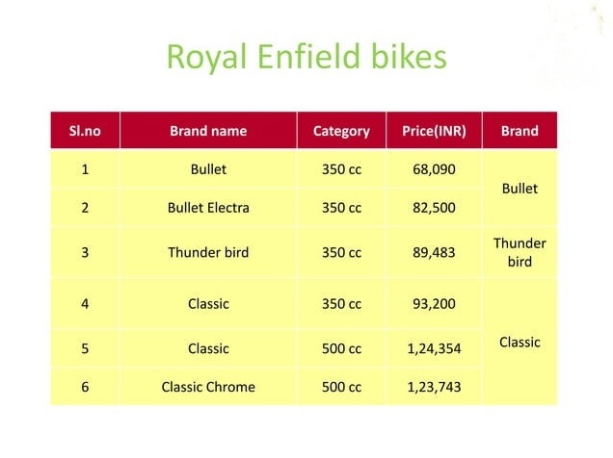

Slide 30
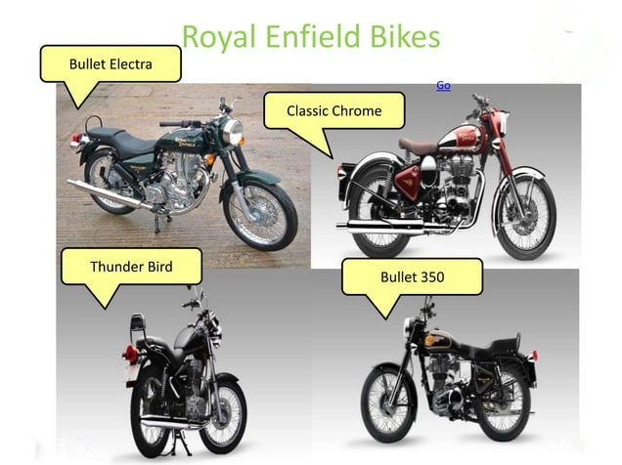

Slide 31
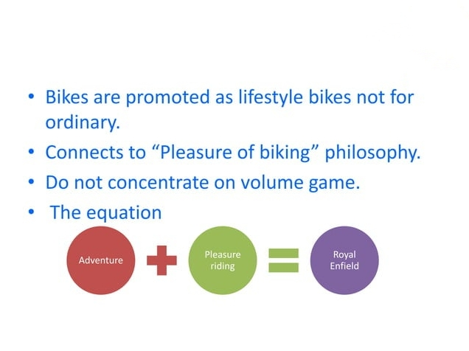
SALIENT FEATURES OF ROYAL ENFIELD

Slide 32
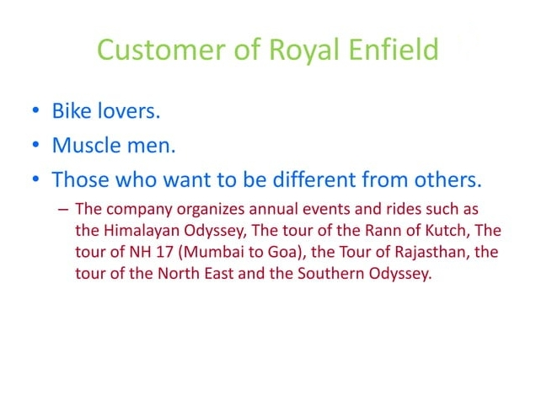

Slide 33


